Slide 1
AI
Hype?
Science Fiction?
Reality?
Robert Zembowicz
Enterprise Architecture/CTO Office

Slide 2
Agenda
Briefly about key AI concepts and AI readiness
Financial industry use cases, including focus on Investment Management
How IT (Global SI and CTO) can help
Candidate Vanguard AI Uses Cases, including IMG

Slide 3
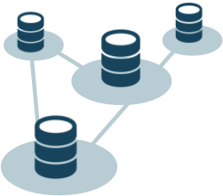






General (Strong) | Narrow (Weak) AI
Broad intelligence, human-like
Narrowly specialized skillset

Slide 4
Current State: General and Narrow AI
General AI
Narrow AI
10-20+ years away, maybe more
Not sure whether it is possible at all to “be like a human”
Conscious? Well, we don’t know what it is even for humans…
Active research to “broaden” narrow skills and integrate them
Having one abstract concept across multiple “senses”: text, speech, image, video, spatial, …
Other research areas: one-shot learning, memory, reasoning, …
Very fast progress in research and experimentation
Growing number of quite successful business applications
Several platforms and ready-to-use services
“Smart Tools”
(personal, business)

Slide 5
AI / Machine Learning / Deep Learning
AI
Popular Example:
Chess – DeepBlue vs Gary Kasparov
Driven by Rules
Machine Learning
Popular Example:
Email Spam Filtering – classifying spam
Driven by Data
Deep Learning
Popular Example:
Image Recognition – identifying objects, tagging people
Driven by Data
Many levels of abstraction

Slide 6
AI: The Next Paradigm Shift
Business
IT
New approach to solving business problems
Use all data
Minimize data/feature prep: let the machine figure out features and concepts
Requires solid data
New approach to building applications
“Programmers become teachers instead of micro-managers”
AI developer is training an algorithm on data, instead of writing precise instructions what a program should do
Common Challenge
Understanding and accepting that machines are becoming imperfect (like us, humans), and how to deal with this
Why Now? Key Three Ingredients:
- Data
- Deep Learning Algorithms
- Multicore Compute

Slide 7
Most Promising Applicability Areas
Industries
Cross-Industry Use Cases
Healthcare
Financial
Retail
Legal
Education
Agriculture
HR
News Aggregation
…
Fraud Detection
Cyber Security
Compliance Monitoring
Customer Experience
Marketing Optimization
…
AI is much more than just chatbots and virtual assistants

Slide 8
AI in the Real World
General Applications
Financial Industry
Image Recognition
Handwriting Recognition
Automated Speech Recognition
Natural Language Processing
Language Translation
Self-Driving Cars
Preventive Maintenance
Targeted Marketing
Chatbots/Conversational UI
Cognitive Advisors and Assistants
Fraud Detection and Prevention
Personalized Financial Services
Financial Advisors and Planners
Wealth Management Advisory Services
Smart Wallets: monitor, coach, alert
Customer Service, VOC
Fund/Investment Management
Compliance Monitoring
Contracts Intelligence: legal analysis
Management Decision Making
Process Automation

Slide 9
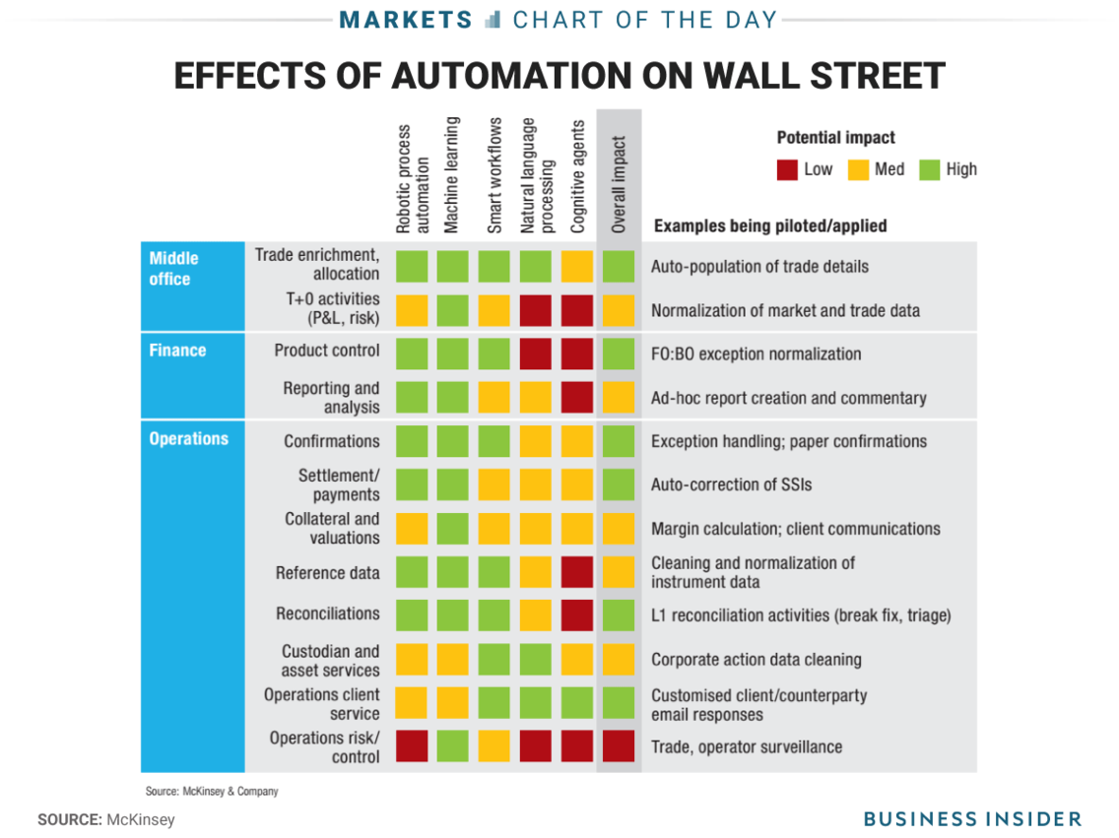
McKinsey on Impacts in Financial Ind.

Slide 10
AI and the Financial Industry Fidelity Investments
Q: What emerging technologies are you excited about?
A: “The ones that we're putting more emphasis on are the various forms of artificial intelligence. AI-type systems will start to hit their stride. When you think about a lot of the interaction we have with the customers, much of the information to answer questions could be provided by machines. The phone reps could spend more time focused on the customers' needs rather than looking things up.”
Stephen Neff, Fidelity Investments CTO
Source: “Fidelity's top IT exec sees potential in A.I.” – ComputerWorld (2014) http://www.computerworld.com/article/2847330/fidelitys-top-it-exec-sees-potential-in-ai.html

Slide 11
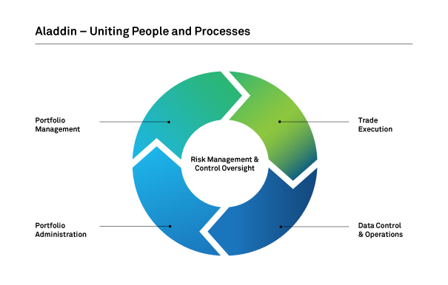
AI and the Financial Industry BlackRock’s Aladdin
Help inform investment decisions
Used internally and externally
Nearly 30,000 people use Aladdin
Based on Hadoop & OpenSource
Natural-language processing
Documents, news stories, broker reports, Social Media
Satellite Image Processing
E.g., how full parking lots are
Generates a sentiment score on the entities or companies
BlackRock announced they are adding more and more AI algorithms to their Aladdin platform
https://www.financial-planning.com/news/what-happens-when-ai-rewires-wealth-management

Slide 12
AI and the Financial Industry Investment Management
AI can help financial firms with:
Information Advantage: traditional and alternative data
Investment Strategy Advantage: using better algorithms
Compliance monitoring
Examples:
News summarization
News sentiment assessment
Automating investment research
Portfolio management
Algorithmic trading models
Trading execution
Risk management
Anomaly Detection
Rogue or insider trading

Slide 13
AI – 2018 CTO Goals
Through collaboration with other groups at Vanguard
AI
Partnership on
1. Continue Getting Smart on AI
- Educate Business and IT, individual contributors and leaders
- Learn from Partners and Consulting Companies
- Continue research on approaches and use cases in the Financial Industry
2. About 3 Vanguard-Specific Experiments
- Preferably real business problems
- CTO role: observe | enable | consult | partner
- Build interest and appetite to finance project(s) for 2019
3. AI Competency
- How to attract / hire externally
- How to grow talent in-house
- Establish AI Community
4. Environments for Deep Learning
- Evaluate tools/frameworks/libraries
- How to do DL on laptop/desktop/server/instance/cluster
5. Architecture for operationalizing AI models

Slide 14
How Can We Help? The CTO Engagement Model
CTO Role | Explanation
Observe | Track progress Collect lessons learned and share with others
Enable | Above + Identify needed environments and assist with implementing them Bring required tools, libraries, frameworks, … Suggest training classes and other resources
Consult | Above + Advice on approach details Teach, train, transition know-how [No access to data required]
Partner | Above + Co-develop models [Access to data required]

Slide 15
AI: Deep Learning and Natural Language Processing – Candidate Use Cases
AI
DRAFT
Business Group | Use Case | Contacts | CTO Role?
IMG-Fintech | Multiple Fintech Experiments | Warren Pennington, John Evans, Michael King | Partner
IMG-QEG | Text Analytics: SEC 10-K and 10-Q Filings | Scott Rodemer, Neeraj Bhatia | Partner
IMG-QEG | Performance/Risk Control Models (*) | Paul Musella, Michael Shertok, Frank Perry | Enable
IMG-ISG | Improve Market Forecasting Models Factor Returns Currency and Commodity Returns | Roger Aliaga-Diaz, Harshdeep Ahluwalia | Partner
(*) Details withhold – sensitive to QEG
Note: partial list – business interviews in progress, potentially uncovering more use cases

Slide 16
AI: Deep Learning and Natural Language Processing – Candidate Use Cases
AI
DRAFT
Business Group | Use Case | Contacts | CTO Role?
IMG-RMG | Forecasting Bond Credit Rating Changes | William Liang, AJ Johnson | Partner
IMG-RMG | Mortgage Desk Bloomberg Messages Summarization and Sentiment Analysis | Zava Aydemir, Owen Meng | Partner
IMG-RMG | UK Trading Data TCA Modeling: Assess Performance of Trading Algorithms | Miles Huffman, Kaveh Taghavi, Amandeep Aurora | Consult
IMG-RMG | ? [details pending…] | John Wertz, Shantanu Bapat
IT&S-Security | Intrusion Detection POC | Mia Harkins, Julie Liu, Paul Gorski | Partner
Note: partial list – business interviews in progress, potentially uncovering more use cases

Slide 17
AI: Strategy and Innovation Initiatives Supported by CTO
AI
DRAFT
Business Group | Initiative | Contacts | CTO Role
IMG-Fintech | Fintech Strategies | Warren Pennington, John Evans, Michael King | Partner
IT&S-Security | Security Innovation and Assurance | Mia Harkins, Raj Gurwinder, Julie Liu | Consult
IT&S-Advice | Advice Strategy Development and Experiments | Aaron Taylor | Consult
IIG-PI/CAI | Participant Intelligence AI Strategy Development | Brian Alling, Eduardo Fontes | Consult
CAI | Identify and pilot AI use cases | Jing Wang, Eduardo Fontes, Don Scheibe | Consult
MTO | Mail optimization with AI/Machine Learning? [details pending] | Scott Wentz | Consult
Note: partial list – ongoing discussions will likely add more initiatives that CTO will support

